Slide 1


Fintech Linkages with Affordable Housing and Digital Economy
Dr. Babatunde Obrimah
COO, FintechNGR

Slide 2

What is Fintech?
Organisations combining innovative business models and technology to enable, enhance, and disrupt financial services
EY Census report, 2021

Slide 3


Key Fintech Sectors in Nigeria​
InsurTech
3%
Cryptocurrency
8%
Enterprise Services & Infrastructure
13%
Savings, Investment & Crowdfunding
15%
Lending
23%
Payments, MM & Digital Banking
38%
Source: EY Fintech Report, 2020

Slide 4
Education
6.0%
Health
6.1%
Disposable Income Trend
Transport
6.4%
Disposable
Income
Food
56.7%
Source: BusinessDay/NBS, 2021

Slide 5
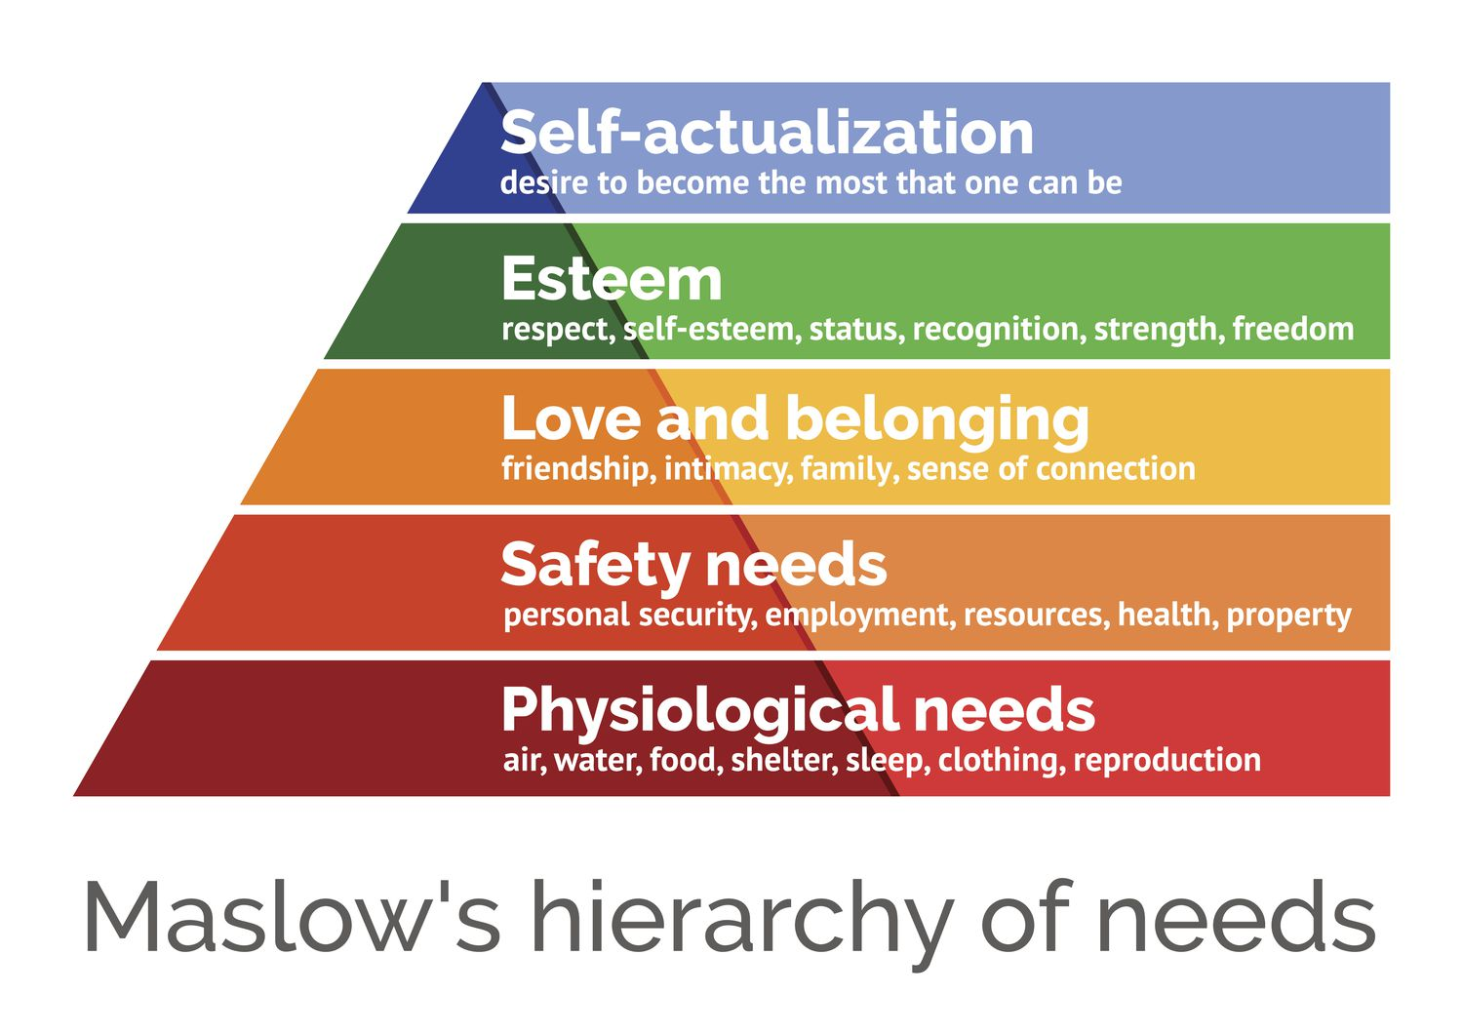

Slide 6

Affordable Housing & Challenges
Affordability Issues – Funding/cost mismatch
Supply-Demand Mismatch
Financial Accessibility
Infrastructure and Services Gap
Socioeconomic Inequality
Government Policies and Regulations

Slide 7
Digital Economy & Fintech Solutions
The digital economy refers to the economic activities powered by digital technologies, including e-commerce, digital services, and online transactions (World Bank, 2021).
Overview of Fintech solutions for Affordable Housing
Digital lending platforms
Blockchain applications in property transactions

Slide 8








PROPTECH COMPANIES

Slide 9
Positive impacts of Fintech linkages with Affordable Housing
Increased access to financing
Efficient and secure property transactions

Slide 10

Conclusion
Fintech is not just a catalyst for change; it's a transformative force connecting the dots between affordable housing and the digital economy.
Together, we can build a future where financial empowerment and digital growth are accessible to all

Slide 11

Thank You

